Slide 1
Spying on the Smart Home: Privacy Attacks and Defenses on Encrypted IoT Traffic
Noah Apthorpe, Dillon Reisman, Srikanth Sundaresan, Arvind Narayanan, Nick Feamster
(Submitted on 16 Aug 2017)
From arXiv.org

Slide 2
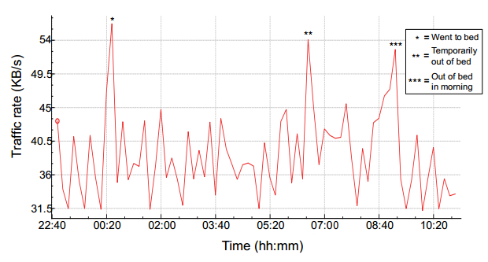
Background
Many smart home devices have always-on sensors that capture users’ offline activities and transmit information about these activities outside of the home.
ISPs, Wi-Fi eavesdroppers, or state-level surveillance entities can infer privacy sensitive in-home activities.
Notes:
(sleeping patterns, exercise routines, child behaviors, medical information……)
using built-in motion, light,temperature, air quality, and microphone sensors

Slide 3
Related Work
01
Attack
The Fingerprint and Timing-based Snooping (FATS) attack
Website fingerprinting attacks
02
Traffic shaping
Independent link padding algorithms: CIT vs (VIT) independent link padding
a dependent link padding algorithm
an adaptive padding algorithm
Notes:
Last-mile 术语，骨干网的边界节点(接入节点)到用户计算机之间的网络中不超过2公里的位置
开发了一种自适应填充算法，该算法通过匿名网络节点来强制间隔短时间的网络通信，以匹配预先指定的概率分布。

Slide 4
Threat Model
Passive network observer with access to last-mile Internet traffic into and out of a smart home.
Packet contents are encrypted and the adversary must rely on traffic rate and packet header metadata to infer user activities.
The passive network adversary can obtain a database of labeled traffic from smart home devices for training machine learning algorithms.
Notes:
Last-mile 术语，骨干网的边界节点(接入节点)到用户计算机之间的网络中不超过2公里的位置

Slide 5
Experiment Setup
a Raspberry Pi 3 Model B as an 802.11n wireless access point
popular IoT devices:
1. Sense Sleep Monitor 2. Nest Cam Indoor security camera 3. Amcrest WiFi Security IP Camera 4. Belkin WeMo switch 5. TP-Link WiFi Smart Plug
6. Orvibo Smart WiFi Socket 7. Amazon Echo
Notes:
This setup allowed us to record all network traffic to and from the smart home devices connected to the Raspberry Pi’s Wi-Fi network as pcaps and IPFIX records. The Raspberry Pi also provided a convenient platform for implementing our proposed traffic shaping solution.
利用内置的运动、光线、温度、空气质量和麦克风传感器来分析用户的睡眠模式和睡眠环境
Amcrest和Nest的摄像头是一款永远在线的摄像头，可以通过基于云的网络和移动应用来实现动态检测和实时流媒体直播
WeMo、TP-Link和Orvibo设备都是带有开关的电源插座，可以由智能手机应用程序远程控制
亚马逊Echo是一款语音助手，它可以响应用户的查询，并能与其他基于云计算的服务和物联网设备进行交互。

Slide 6
Traffic Rate Privacy Attack
Device Identification
Activity Inference

Slide 7
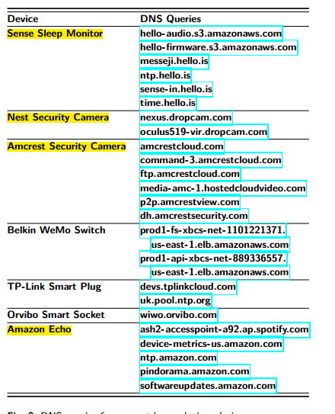
Device Identification
"traffic flow“: sender_ip, recipient_ip, sender_port,
recipient_port, and protocol
Using MAC Addresses
Using DNS Queries
Using Traffic Rates
proportion of SYN and ACK packets per flow, the number of packets in a flow, distributions of inter-packet intervals ……

Slide 8
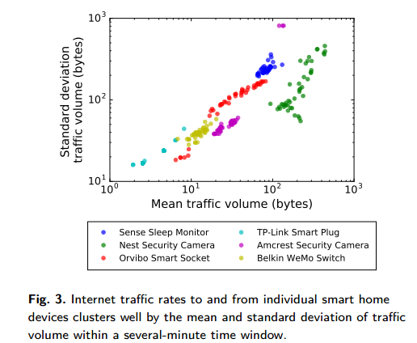
Device Identification
separated this traffic into flows corresponding to individual devices and converted into time series vectors
divided these vectors into w-second windows and extracted 2-element feature containing the mean and standard deviation of the traffic amounts in the samples of each window

Slide 9
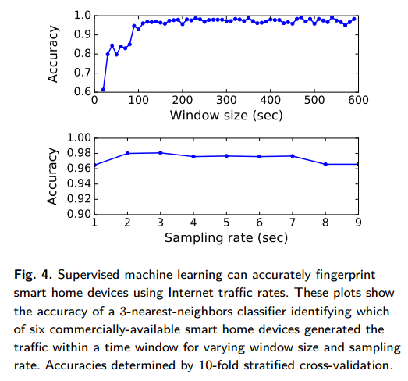
Device Identification

Slide 10
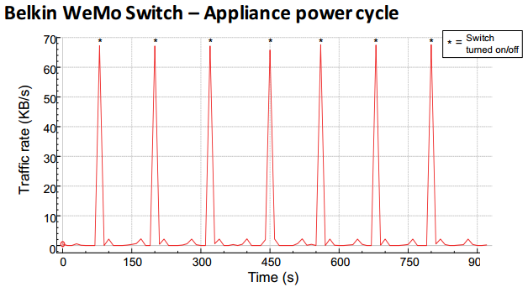
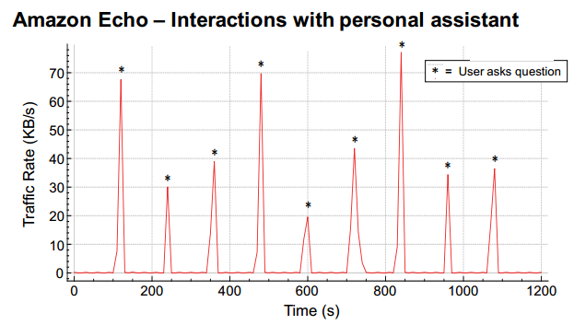
Activity Inference
Changes in traffic rate correlated to device state changes caused by user activities
Notes:
3 questions repeated 3times, one question every 2 minutes. SSL traffic Although the Echo sent and received other TCP traffic to different domains during this time, we were able to identify the stream that correlated with the questions

Slide 11
Activity Inference

Slide 12
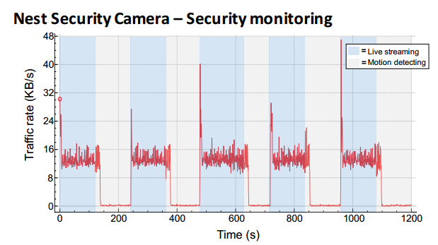
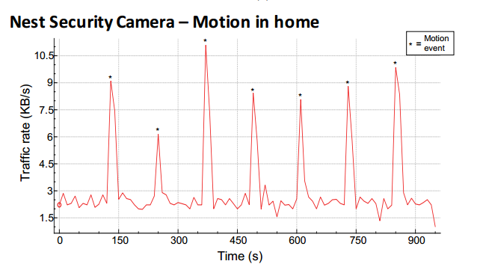
Activity Inference
Nest Security Camera has at least two primary modes of operation: a live streaming mode and a motion detection mode.
Notes:
the camera’s video feed is either being actively viewed by the user through the Nest web/mobile application or the feed is being uploaded in real time to be stored on the cloud.
the camera is monitoring the stream locally for movement. If movement is observed, the camera records a snapshot of the video and alerts the user
a white screen with a black square move
observe the presence and frequency of motion inside a smart home

Slide 13
Evaluating Current Defenses
Blocking Traffic
Most devices retained limited functionality and others had no functionality without Internet connection and were completely unusable.
Tunneling Traffic
This would impede a last-mile observer’s ability to split traffic into individual flows and associate those flows with specific devices.
Notes:
the source IP address of the home gateway router and the destination IP address of the server implementing the VPN exit point
When many IoT devices send traffic simultaneously, noise variations in traffic rates of high-rate devices could mask the entire traffic patterns of other devices.

Slide 14
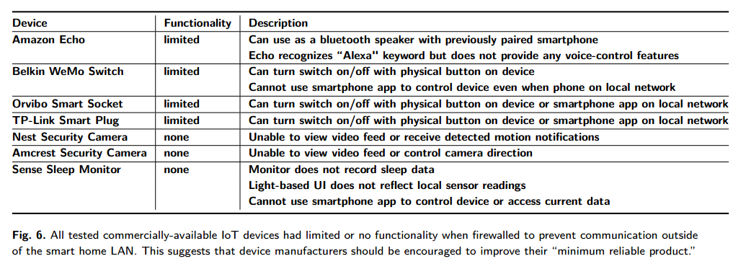
Blocking Traffic
Notes:
A hub or router could use more advanced analysis to discern what specific traffic from each device can be blocked safely.
However, encrypted traffic contents and the potential for delayed device failures

Slide 15
Tunneling Traffic
Single device
Sparse activity
Dominating device

Slide 16
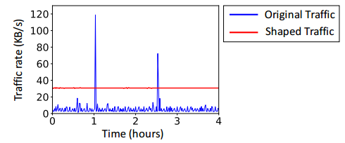
Traffic Shaping
They propose traffic shaping using independent link padding (ILP).
If the shaped send rate is lower than the rate of device traffic, packets from the devices are delayed in a queue until they can be sent at the shaped rate.
If the shaped rate is higher than the rate of device traffic, fake packets (cover traffic) are added.
a trade-off between latency and bandwidth overhead

Slide 17
Traffic Shaping Implementation
The implementation consists of two components: a VPN tunnel and a traffic shaper.
VPN tunnel
They use OpenVPN on an Amazon EC2 t2.medium instance as the endpoint for traffic originating from their smart home access point.
The requirement of the VPN is that it sit outside of the last-mile observer’s view.
Traffic shaper
We built our traffic shaping implementation around the Linux kernel’s traffic control systems, configurable via the tc command line tool.
Notes:
a user can modify the kernel’s strategy for how it queues and sends network packets.

Slide 18
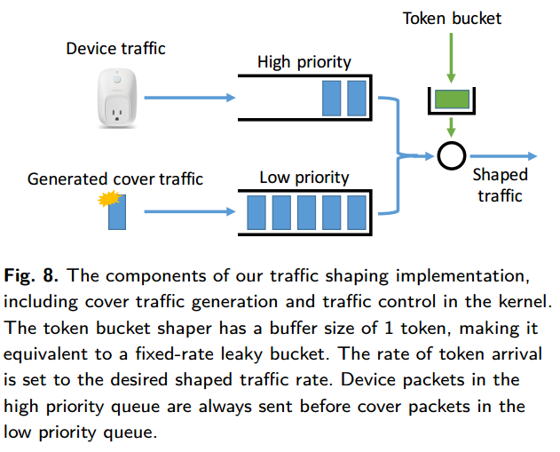
Traffic Shaping Implementation
Notes:
1. a user space program generates UDP cover traffic sent to a dummy IP address
2. create a new PRIO queuing discipline (qdisc). The PRIO qdisc has three priority classes for packets.
Set a traffic control filter so that device traffic is assigned to a high priority queue, and generated cover traffic is sent to a lower priority queue.
3. Replace default first-in-first-out queuing discipline of tun0 with a hierarchical token bucket (HTB)

Slide 19
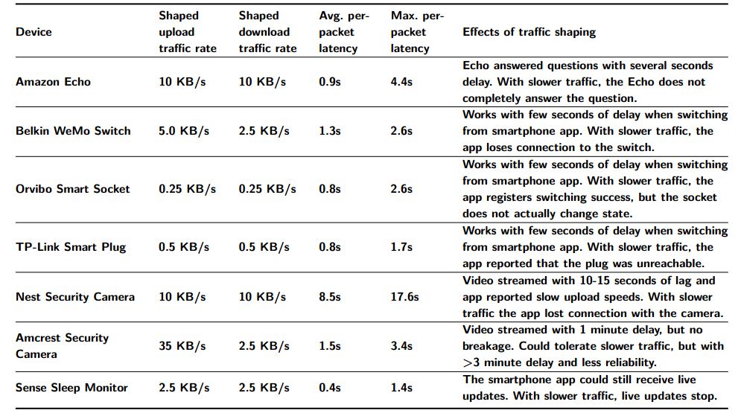
Devices Tolerate High Latencies
Shaping Incurs Acceptable Throughput Overhead
Notes:
对延迟的容忍度
可接受的吞吐量开销

Slide 20
Shaping is Feasible for Many Users
Network performance cost
The average upload speed for fixed broadband in the United States was 2.36MB/s as of June, 2016. For users with at least 2MB/s upload speed, a bandwidth overhead ≤ 40KB/s (above the required shaping rate for any of our tested devices) amounts to ≤ 2% of the user’s upload capacity.
Data usage cost
As for non-audio/video devices, traffic shaping that adds 7.5KB/s bandwidth overhead would only amount to 19GB of extra data used per month.
As for audio/video devices, traffic shaping that adds 40KB/s bandwidth overhead would count towards 104GB of a data cap in a month.
Data costs $10 per 50GB.
Traffic shaping that adds 104GB of data would only count towards 10% of a 1TB data cap in a month.
Notes:
India as having some of the slowest connection speeds in the Asia-Pacific region, with 1.7 megabits per second average download speed in 2014

Slide 21
Real-world Deployment Considerations
01
Constant versus variable rate shaping
Due to “system jitter,” the shaped traffic will have very small variations in rate that distinguish periods of high or low cover traffic.
Variable interval timer (VIT) shaping uses a randomly varying send rate independent of the traffic that the shaping is intended to obfuscate.
02
Shaping an entire smart home
Their simulation of VIT traffic shaping using a 24-hour packet capture from multiple smart home devices resulted in less cover traffic overhead than shaping the most bandwidth-intensive device individually.

Slide 22
Discussion
Traffic shaping is practical.
Tunable traffic shaping.
Options for device developers.
Trust in VPNs.
Minimum reliable product.

Slide 23
THANKS
谢谢聆听

